Slide 1
Loan Repayment Challenge

Slide 2
Introduction
Loan lending has been an important business activity for both individuals and financial institutions. Profit and loss of financial lenders to an extent depend on loan repayment.
Loan default prediction is a crucial process that should be carried out by financial lenders to help them find out if a loan can default or not.
Successful loan default prediction can help financial institutions to decrease the number of bad loan issues and eventually increase profit.
In this assessment, we want to predict which loan has the high probability of being default based on their financial information and payment history so that the lender can identify the high risk loan and take action in advance to prevent the business from losing money.
From business context, we want to reduce the number of bad loan which lead to a loss for the lender.

Slide 3



Data Gathering
loan.csv (Funded loan only)
payment.csv
clarity_underwriting_variables.csv
final.csv

Slide 4
Data Gathering
Since our final target is to predict if the loan is a good loan or bad loan. We have to modify the loan status and convert the problem into a binary classification problem.
Class 0: Good Loan
Paid Off Loan : Loan that has been paid off.
Settlement Paid Off : Loan that has been settled or paid off earlier.
Class 1: Bad Loan
External/Internal Collection : Collection is when a collection agency (internal/external) collects the past-due debts from borrowers.
Settled Bankruptcy : Loan that has been settled or paid off after bankruptcy.
Charged Off Paid Off : Charged off loan that has been paid off. (creditor has written the account off as a loss and closed the account)
Charged Off : Creditor has written the account off as a loss and closed the account.
Class 2: Neutral Loan (To be ignored)
New Loan : A completely new loan
Returned Item : Missed 1 payment (but not more) due to insufficient funds.
Pending Paid Off : Loan waiting to be paid off.
Settlement Pending Paid Off : Settlement loan waiting to be paid off.

Slide 5
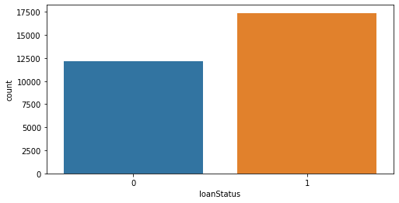
Data Gathering
41.11%
58.89%
We could apply some technique like upsampling or downsampling to deal with the imbalanced data, but since the difference is not too much, so we will remain as it is.

Slide 6
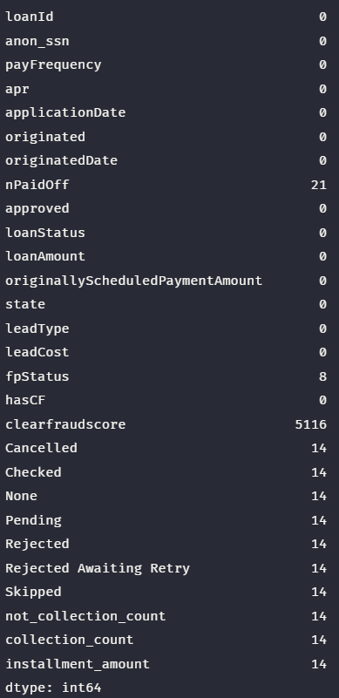
Exploratory Data Analysis
For nPaidOff and fpStatus, we have less missing values and we can replace the missing value with the mode value.
For all the payment status, since they have missing value in all the payment status caused by left join and the number is less, so we can just drop them.
For clearfraudscore, it is logically an very importance feature for the model, hence we have to treat it carefully. We will deal with it afterward.

Slide 7
Exploratory Data Analysis
Most of our data are skewed. Skewed data degrades the model’s ability (especially regression based models) to describe typical cases as it has to deal with rare cases on extreme values.
Skewed data also does not work well with many statistical methods. However, tree based models are not affected.
Methods dealing with skew data:
Log transformation
Remove outliers
Normalize (min-max)
Cube root or Square root
Reciprocal
Square
Box Cox transformation
Since we are using tree based models, we are not going to perform any transformation.

Slide 8
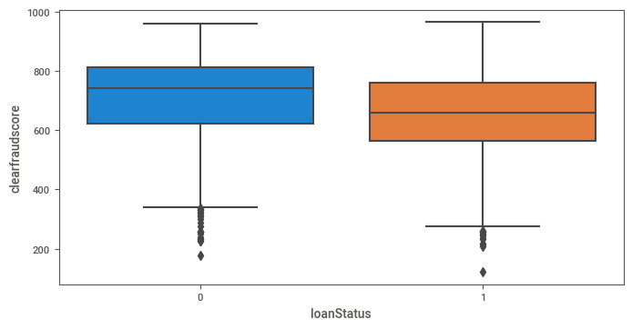
Exploratory Data Analysis
41.11%
58.89%
Just a slight difference between the good loan and the bad loan. The upper quartile, median, lower quartile and minimum value in the bad loan are lower compare to the good loan.
Both boxes have lots of overlapping, hence we cannot conclude the loan status using clearfraudscore.

Slide 9
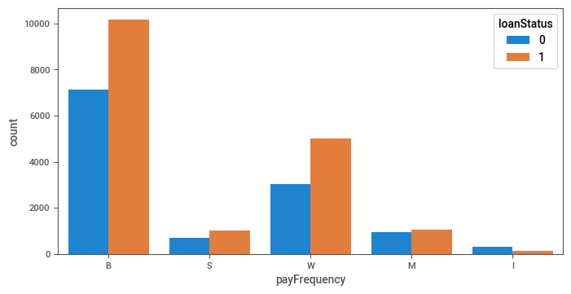
Exploratory Data Analysis
41.11%
58.89%
Interesting to see that biweekly payment and weekly payment has more bad loan than good loan.

Slide 10
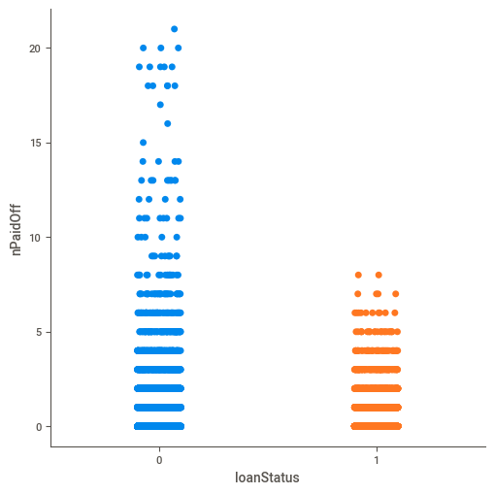
Exploratory Data Analysis
Both loans have most number of paid off loan around 0 - 5.
Loan with higher number of paid off loan is usually a good loan.
41.11%
58.89%

Slide 11
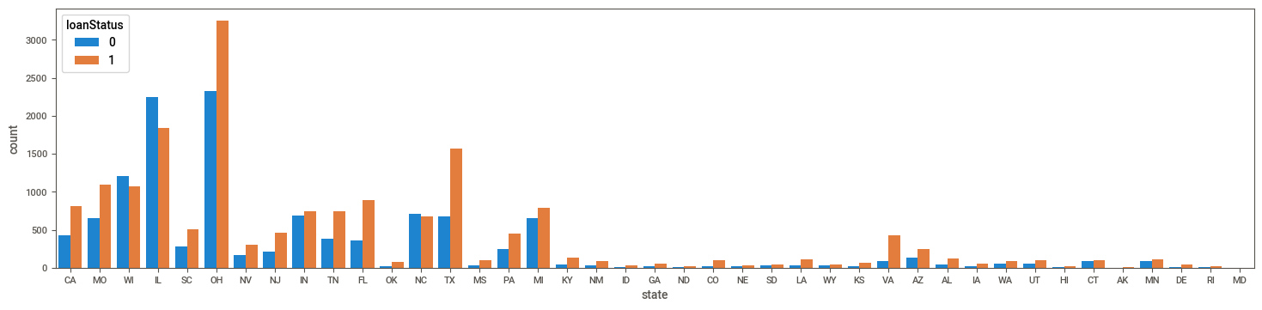
Exploratory Data Analysis
41.11%
58.89%
Some state such as OH, TX, MO have more bad loan compare to other state. Maybe we can reconsider and stricten the loaning rules in these state to reduce the number of bad loan?

Slide 12
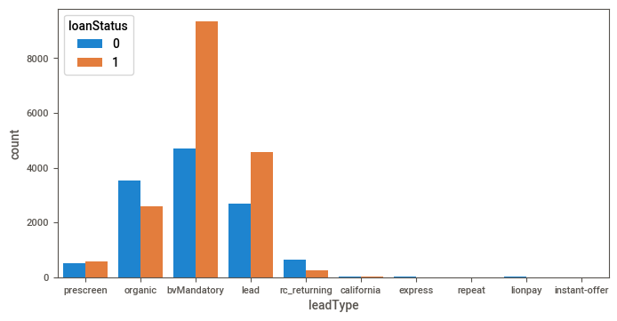
Exploratory Data Analysis
41.11%
58.89%
Interesting to see that bvMandatory and lead have more bad loan compare to other lead type. But I don't think leadType will affect the model a lot.

Slide 13
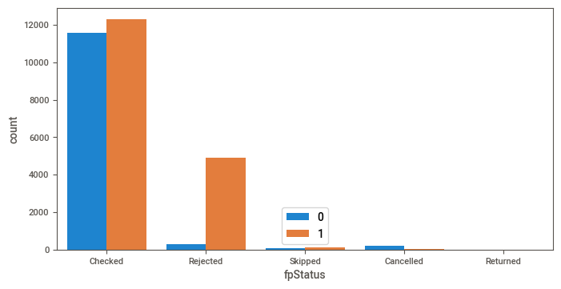
Exploratory Data Analysis
41.11%
58.89%
Usually loan that has a rejected first payment has a higher probability to become a bad loan.

Slide 14
Exploratory Data Analysis
From the short exploratory data analysis above, we could generate some quick insights.
The clearfraudscore is lower in the bad loan but we cannot conclude using it since there are lots of overlapping.
Biweekly payment and weekly payment has higher number of bad loan.
Bad loan usually has higher apr.
Loan with higher number of paid off loan is usually a good loan
Some state such as OH, TX, MO have more bad loan compare to other state.
Lead type == bvMandatory and lead have more bad loan compare to other lead type.
Loan that has a rejected first payment usually has a higher probability to become a bad loan.

Slide 15
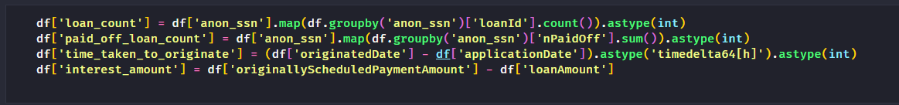
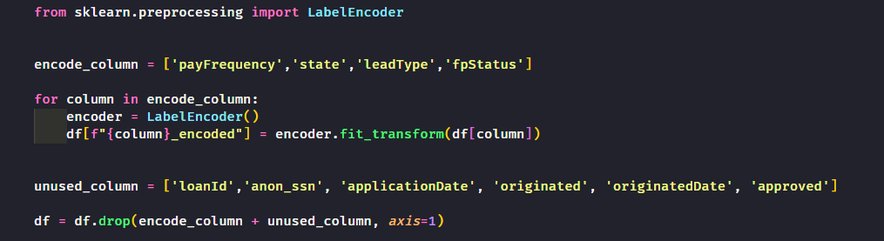
Feature Engineering
Create and derive new features to our model.
Encode categorical value into numerical value and drop unwanted columns.

Slide 16
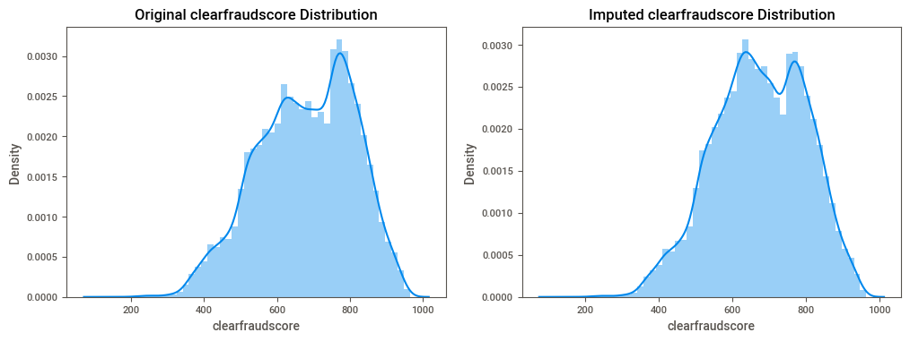
Feature Engineering
Since clearfraudscore is logically one of the important feature that will directly affect the model, hence I choose to use the KNNImputer that use KNN algorithm to predict the missing clearfraudscore.

Slide 17
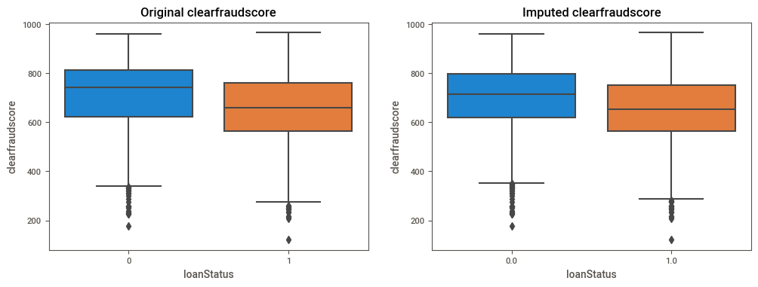
Feature Engineering
The original information is not affected too much. KNNImputer has did a great job.

Slide 18
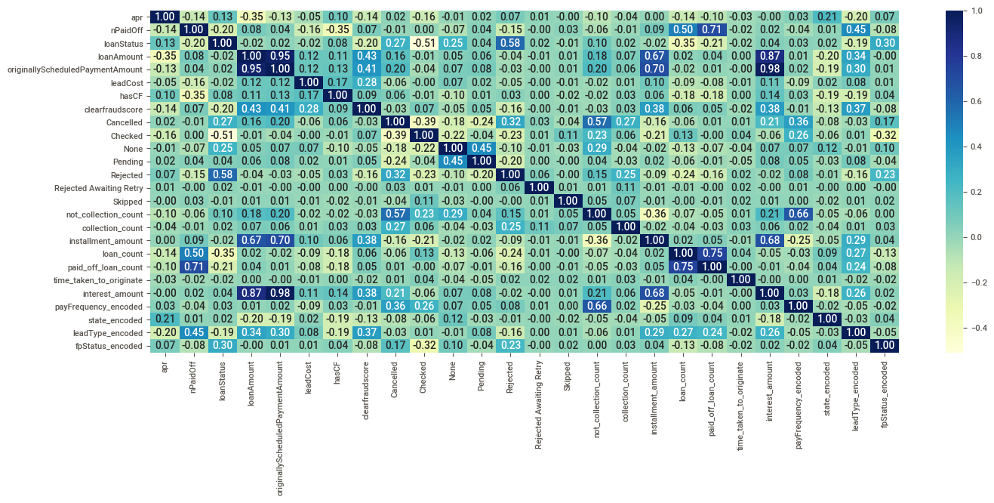
Feature Engineering
loanAmount, interest_amount and originallySchedulePaymentAmount are highly correlated.
Since correlated features don't improve model, we could remove the highly correlated feature.

Slide 19
Modelling
Ensemble Learning
Bagging and boosting are both ensemble learning methods, where a set of weak learners are combined to create a strong learner that obtains better performance.
These methods are designed to improve stability and accuracy of machine learning algorithms. Combinations of multiple classifiers decrease variance and may produce a more reliable classification than a single classifier.
Bagging (Random Forest)
Bagging is a parallel process. Bagging is the application of the bootstrap procedure to a high-variance machine learning algorithm.
The idea behind bagging is combining the results of multiple models (for instance, all decision trees) to get a generalized result.
Boosting (XGBoost)
Boosting is a sequential process, where each subsequent model attempts to correct the errors of the previous model. The succeeding models are dependent on the previous model.
When an input is misclassified by a hypothesis, its weight is increased so that next hypothesis is more likely to classify it correctly. By combining the whole set at the end converts weak learners into better performing model.

Slide 20
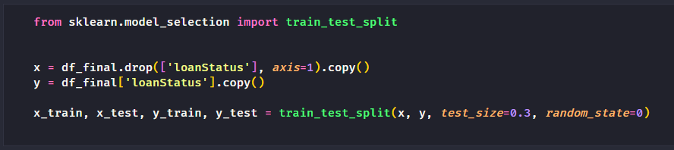
Modelling
The reasons we choose tree-based ensemble learning algorithm
Ensemble learning algorithm helps to improve machine learning model performance by combining several models that allow the production of better predictive performance compared to a single model.
Tree-based models are not sensitive to outliers, missing data, and skewness.
Tree-based models are more interpretable.
As usual, we split the data into 70% of training data and 30% of testing data.

Slide 21
Result
Algorithm | Accuracy | Precision | Recall | F1 Score
Decision Tree | 92.04 | 93.71 | 92.83 | 93.27
Random Forest | 94.15 | 94.47 | 95.76 | 95.11
XGBoost | 94.85 | 95.56 | 95.78 | 95.67

Slide 22
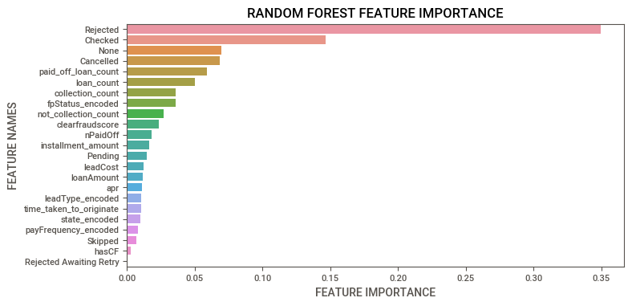
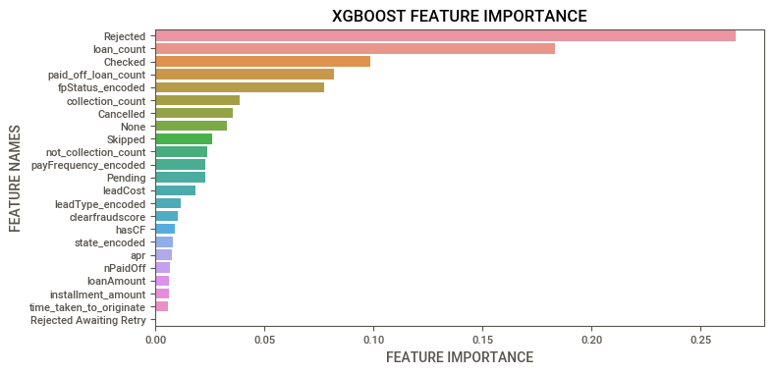
Feature Importance

Slide 23
Conclusion
In this assessment, we achieved 95% F1 score in predicting loans that have the high probability of being default based on their financial information and payment history.
Ensemble learning algorithm helps to improve machine learning model performance. In our case, both Random Forest and XGBoost outperformed Decision Tree.
In our problem, false negative is more expensive than false positive. Hence, we have to decide the metric to evaluate the model carefully. In our case, we used F1 score.
Based on the feature importance generated, we can conclude that the number of payment status such as Rejected, Checked, Cancelled, and None, as well as the number of loan, number of paid off loan, first payment status, and maybe clearfraudscore have higher impact on our model. Hence, these are some important to look at when predicting the loan status. The lender could also use it as a validation features criteria in approval process.

Slide 24
Future Works
Collect more data or use upsampling or downsampling techniques to deal with the imbalanced dataset.
Try different model like Logistic Regression or SVM. But transformation have to be done because skewed data will affect the performance in these model as describe previously.
Try deep learning model to further increase classification performance but deep learning model is just like a black box and is uninterpretable. Usually in business context, we would like our model to be interpretable.
Use more information provided in the clarity_underwriting_variables.csv file. I decided to use only the clearfraudscore in this file to avoid curse of dimensionality.

Slide 25
THANK YOU

